Slide 1
Integrated Marketing Communications
Valerie Getts Suzanna Stein
Niko Rojas William Buckingham
Cameron Hill

Slide 2
Agenda
Buyer-Readiness Stages
Communication Process
Designing a Message
Promotions Mix
Advertising
Sales Promotions
Personal Selling
Public Relations
Direct Marketing

Slide 3
Buyer-Readiness Stages
Awareness
Knowledge
Liking
Preference
Conviction
Purchase

Slide 4
Communication Process
Sender
Encoding
Message
Decoding
Receiver
Noise
Feedback
Response

Slide 5
Designing a Message
Message Content
Message Structure
Message Format

Slide 6
Company Image And Message
Advertising
Public
Relations
Direct Marketing
Advertising
Personal
Selling

Slide 7
Advertising Decisions
Objectives
Setting
Budget
Decisions
Message Decision
&
Media Decision
Advertising Evaluation

Slide 8
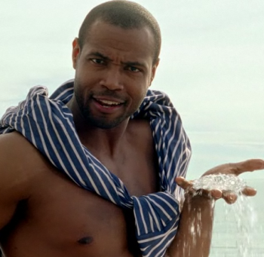
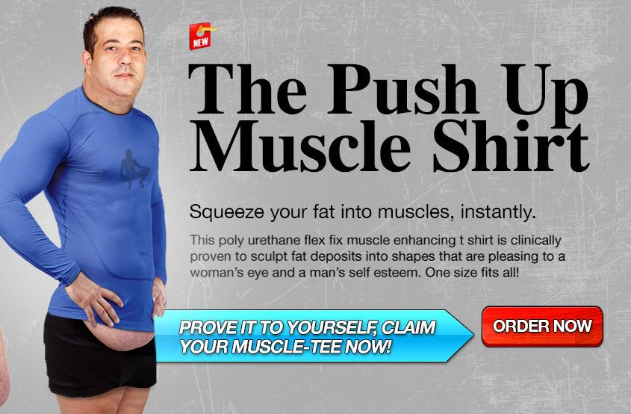
Advertising

Slide 9
Sales Promotion Tools
Consumer Promotions
Trade Promotions
Business Promotions

Slide 10
Sales Promotion
Coupons
Old Spice Classic
Holiday Gift Sets
Free Sample with Purchase

Slide 11
Selling Process
Team Selling
Internet Sales
Individual Selling
Prospecting and Qualifying
Preapproach
Approach
Presentation and Demonstration
Handling Objections
Closing
Follow-up

Slide 12
Public Relations
Ensure positive image
More cost-effective than advertising
Deliver messages through a select few company images/campaigns
Response channels to public
Ask for public engagement and feed back
Notes:
Public relations, especially once the company is known, allows companies to build relationships in often times free settings. I.e. YouTube, community service, online forums only require labor expenses, not pricey ad times.
The Old Spice Man has been one of the most successful public relations campaigns of all time. The most viewed company channel on you tube, with the second most amount of followers.
Fast and constant response to public comments and questions via 30 second videos featuring the old spice man. This made customers feel they were really being listened to. Responses often times de-flattered the company, instead honoring normal people. Responded to talk show hosts’ conversations about Old Spice, taking advantage of those celebrities’ popular channels.
Responses to public’s comments encouraged people to watch and comment. On top of this, Old Spice has encouraged other peoples’ parodies of their videos by commenting on these and encouraging such heightened engagement.
This ultimately shows the public that the company cares and will make public involvement worth peoples’ time. This has helped the company create one of the largest and most successful public relations campaigns which can easily and quickly reach hundreds of thousands of people each message.

Slide 13
Public Relations Tools
222,000
Followers
21,827
Followers
409,312
Followers
Events, written materials, communities, social medias, and publicity
Create constant visibility and conversation
Demonstrate corporate social responsibility
Make PR entertaining and exciting
Notes:
The Old Spice Man has been one of the most successful public relations campaigns of all time. The most viewed company channel on you tube, with the second most amount of followers.
Most response videos were only permitted a set amount of minutes and two takes, ensuring low costs of public relations.
When Old Spice, or Proctor & Gamble, does something socially responsible, social media allows the company to receive huge benefits in customer perceptions of the brand. This becomes an inexpensive way for Old Spice to gain from its ethical and sustainable actions that otherwise would go largely unknown.
Inexpensive way to implement Pull Strategy through advertisements perceived as humorous experiences, not aggressive product advertising.
People watch Old Spice YouTube videos for pure enjoyment, this helps associate the company with positive experience even if have not purchased the product.

Slide 14
Direct Marketing
Face-to-face
Online
Catalog
Telemarketing
DRTV
Kiosk
Direct Mail
Notes:
Direct marketing is one of the fastest growing marketing tool for promotions. It currently makes for $2 trillion of sales within the U.S.
Accounting for approximately 8% of all sales, direct marketing is growing at an estimated rate of 4.9% a year.
As you can see by the model shown, direct marketing uses face-to-face, online, catalog, telemarketing, direct-response TV, Kiosks, and direct mail.
Direct mail marketing involves creating awareness to possible customers through “snail mail” or the more modern e-mail. Although, with the growth of spam filters traditional mail does do the job.
Such an avenue of marketing generates $12.57 on the dollar and accounts for 31% of all direct marketing methods.
Kiosks allow customers to purchase merchandise through modern and sophisticated vending machine style technology. Best Buy often offers Kiosks in airports with a variety of gadgets that people might need on the road, such as headphones or chargers.
Direct-response TV, or DRTV, are direct interactive commercials provided to TV viewers. These commercials are often customized to each view based off web history and also allow consumers to interact with them. Mostly, they commercials can take you directly to a website to purchase the advertised merchandise.
Telemarketing that accounts for 14.9% of direct marketing are used for business-to-business marketing purposes or toll-free number for consumers to call. These toll free numbers are usually linked to specials ads and promotions.
Catalog marketing has shifted from print to online electronic catalogs. This shift has saved costs on printing and mailing, but print still dominates the market.
Research supports that printed catalogs drive 70 percent of online orders. So don’t expect those paper ads in the mail to stop anytime soon.
The most important direct marketing tool currently is online marketing providing that 80% of US household use the internet. These tool allows companies to offer products in reach of a click, while also building relationships.
Companies online are either click only companies, such as amazon.com or Google that allow you to buy products over the internet via a third party, or they are click-and-mortar companies that offer a combination of online and in-store shopping.
Online marketing also includes blogs, marketing websites that interact with customer before purchase, online advertising through classifies or display ads, and social media.
Buyers will receive benefits of direct marketing through customized ads based off of their preferences, wealth of product knowledge, and immediate interaction with brand.
Also, sellers will se benefits through more focused target marketing, lower costs of marketing ,and building stronger relationships with customers.

Slide 15
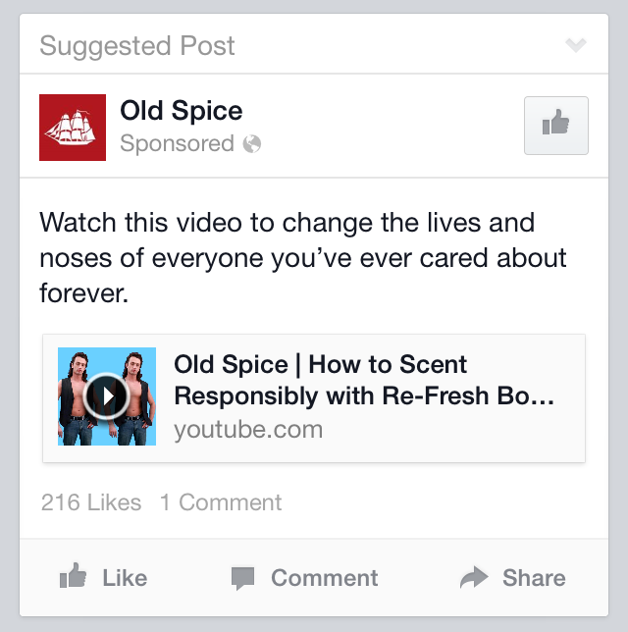
Direct Marketing
Ad-Choices
Direct-response TV
Social Media Ads
Old Spice Voicemail
Custom Response Videos
Notes:
Old Spice uses several different direct marketing strategies to gain customer engagement and loyalty.
Old Spices Ad-Choices system is operated by Proctor and Gamble (P&G), their parent company, that uses consumer’s data from Internet interaction to mold custom ads to consumers.
For example, people who tend to like P&G products or competitor deodorant brands are likely to receive Old Spice ads on the side bar when listening to Pandora radio or interacting with Facebook. . Such ads can be seen on the slide. Website and mobile is shown.
These ads usually are interactive, which allow ad receivers to click the ad that links to social media, videos, promotions, or another variety of web based marketing tools.
Direct-response TV (DRTV) is very similar to Ad-Choice, but consists of short commercials that are also interactive. DRTV is most popular on Hulu and YouTube, which broadcast one to three short ads at a time.
Among those DRTV ads, Old Spice used videos from its “Response Campaign.” The campaign entails customer videos in response to consumers Twitter comments.
Replies were also targeted to celebrities as well. Old Spice created over 180 videos that had over 1 billion media impressions. The campaign targeted directly to the consumers resulted in a 94 million YouTube views.
Facebook follower’s interaction grew by 800% during the campaign. The campaign was not only successful though customer response videos, but reached select members through creative DRTV use and social media.
Old Spice Custom Voicemail was an online marketing campaign that used a custom webpage that allow consumer to interact with the Old Spice brand. The recent Old Spice Custom Voicemail webpage allowed consumers to make a voice mail recording that would “turn them into a man.” The campaign also had a choice for women version too.
In 2007, Old Spice ran another custom web page that had quizzes on how manly a guy was based on ridiculous questions about steak, presidents, and so on. This type of direct marketing makes consumer feel special because of the tailored marketing it produces.
Old Spices direct marketing strategy helped them meet a couple different communications objectives in trying to promote and sell their product.
Ad-Choices and DRTV created awareness and liking of the product. People who didn’t know about the product were exposed to their ads or short videos, and then if they could relate to the videos and thought of them as funny they would begin to like the product.
After liking this product, consumers will come closer to purchasing the product. Other elements of preference compared to other products and conviction that the product is superior to other products, will help the consumer reach the final stage of purchasing.

Slide 16
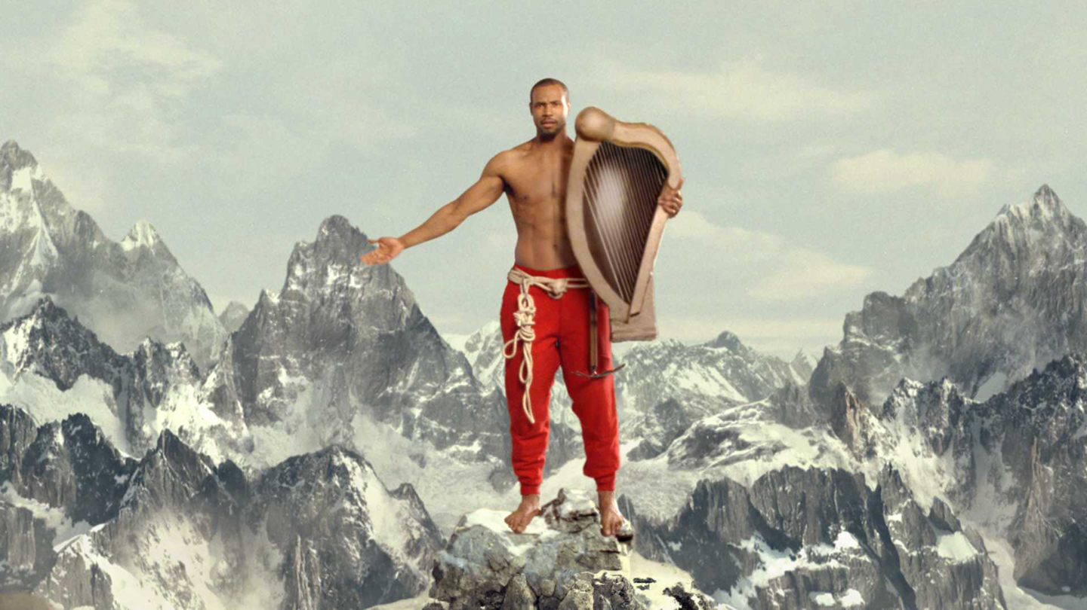

Slide 17
References
http://www.cultureclimax.com/wp-content/uploads/2012/11/espn.jpg
http://www.themouseforless.com/tripplanning/wdwparks/annual/images/OldSpice.jpg
Kotler and Armstrong. (2014). Principles of Marketing. Upper Saddle River, NJ: Pearson Education, Inc.
Oldspice.com
http://www.pg.com/en_US/brands/index.shtml?category=hair

